Slide 1



Presentation
View in Power BI
Last data refresh:
5/8/2021 1:26:49 AM UTC
Downloaded at:
5/8/2021 1:28:59 AM UTC

Slide 2

Intro
Notes:
textbox
No alt text provided.
image
No alt text provided.
image
No alt text provided.

Slide 3
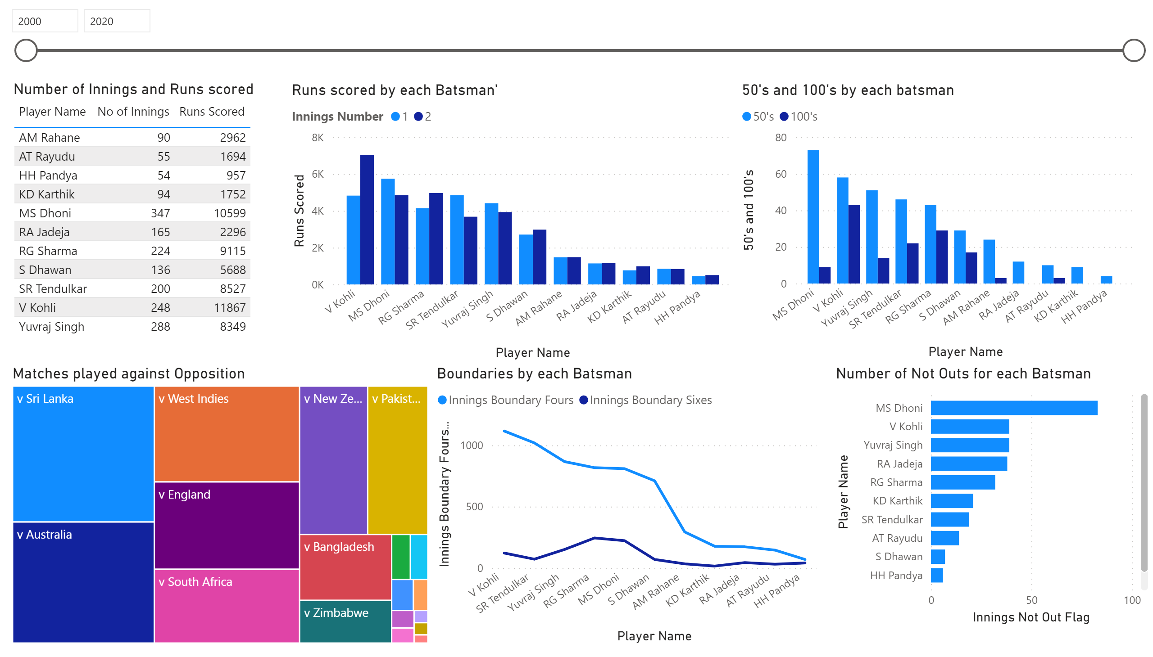
Page 1
Notes:
Matches played against Opposition
No alt text provided.
Number of Innings and Runs scored
No alt text provided.
Boundaries by each Batsman
No alt text provided.
50's and 100's by each batsman
No alt text provided.
Number of Not Outs for each Batsman
No alt text provided.
Runs scored by each Batsman'
No alt text provided.
slicer
No alt text provided.

Slide 4
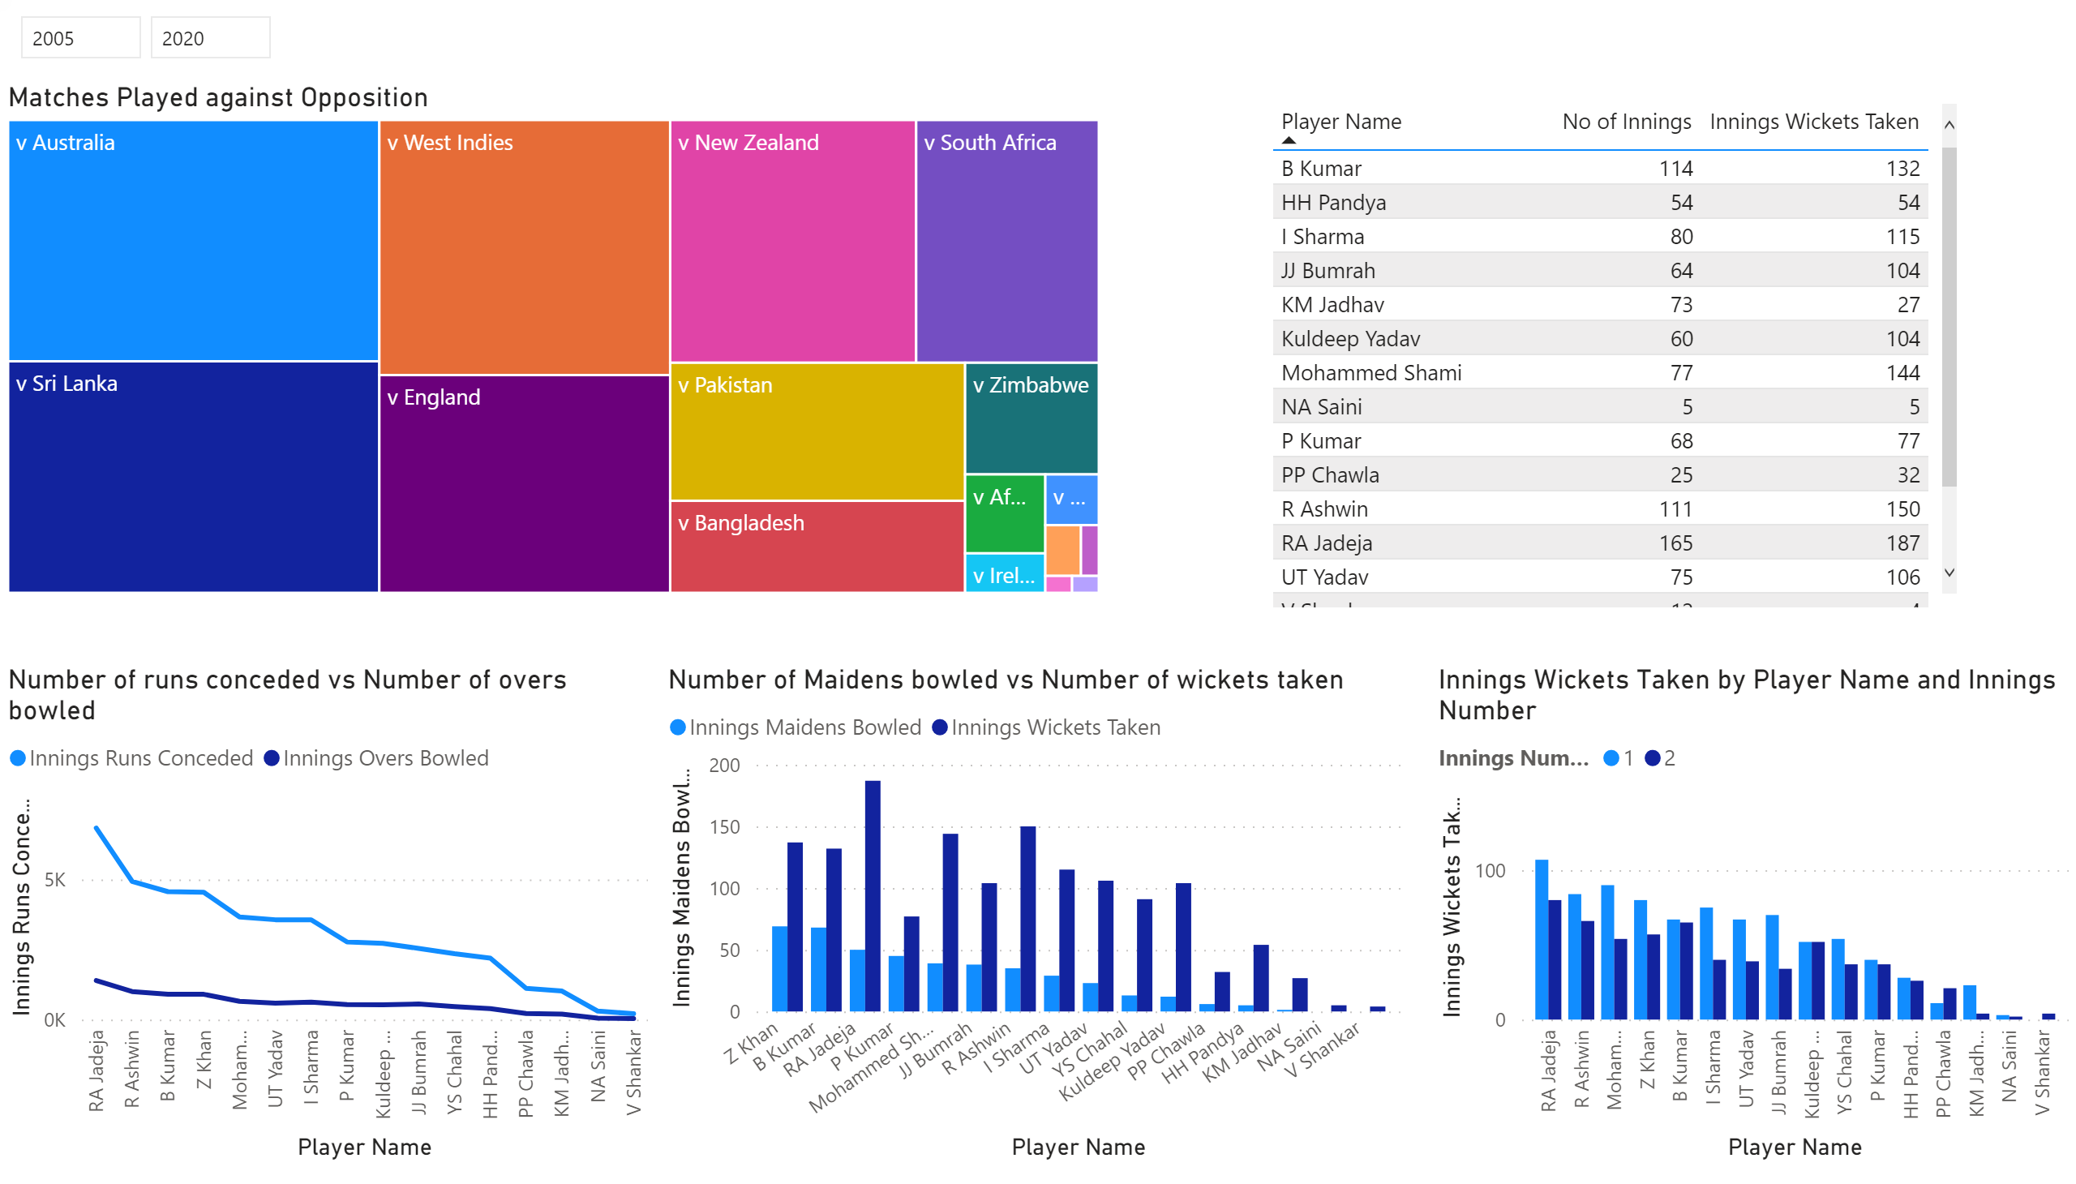
Page 2
Notes:
Matches Played against Opposition
No alt text provided.
tableEx
No alt text provided.
Number of Maidens bowled vs Number of wickets taken
No alt text provided.
Number of runs conceded vs Number of overs bowled
No alt text provided.
slicer
No alt text provided.
clusteredColumnChart
No alt text provided.

